Slide 1




prioritizr Systematic conservation planning in R R
Richard Schuster
richard.schuster@natureconservancy.ca
prioritizr.net

Slide 2








Team
Matt Watts
Joe Bennett
Peter Arcese
Hugh Possingham
Jeffrey Hanson
Richard Schuster
Matt Strimas-Mackey
Nina Morrell
Brandon Edwards

Slide 3
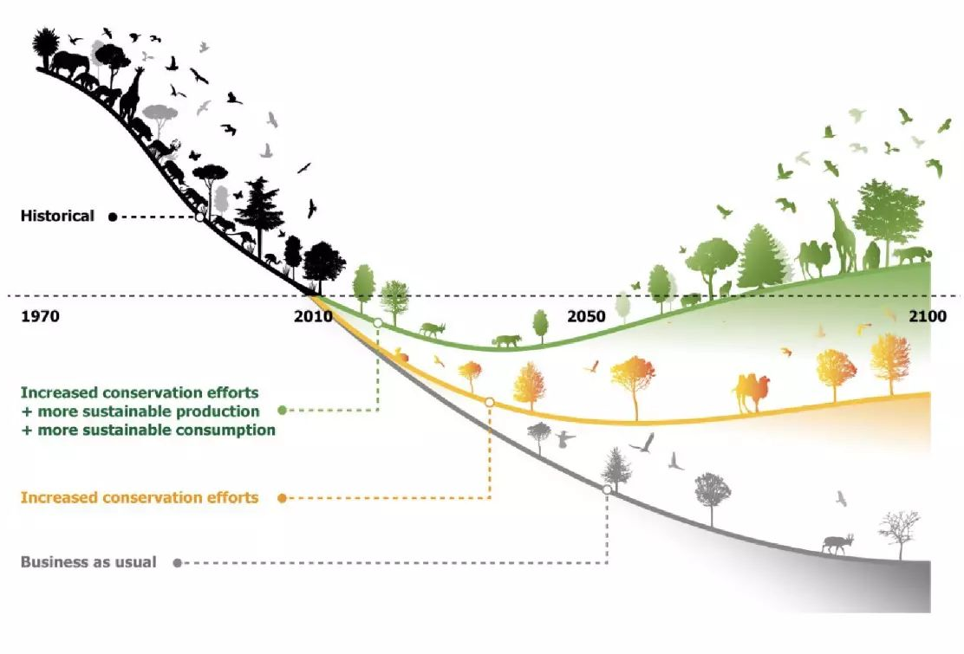
Biodiversity in crisis
https://www.iybssd2022.org/en/bending-the-curve-of-biodiversity-loss/

Slide 4
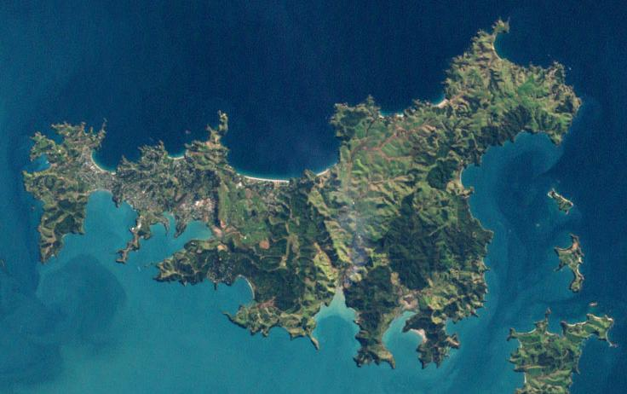
Conservation decision making is hard
Conservation is actions in places
Many facets of biodiversity need attention (e.g., species, habitats, ecosystem services)
Limited resources for implementing actions
Uncertainty in possible outcomes
Need to find compromises among different stakeholders’ values
versus
Lots of potential options for conservation efforts
Giakoumi et al. 2025 https://doi.org/10.1016/j.tree.2024.12.002

Slide 5
How to inform conservation decisions?
Data science is for understanding, describing, and predicting
- Statistical analysis
Machine learning
Clustering algorithms
Ecological forecasting
Connectivity modelling
Species distribution models
Species richness maps
What is? What has been? What will be?
Ecology, Evolutionary biology, Biogeography

Slide 6

How to inform conservation decisions?
Data science is for understanding, describing, and predicting
- Statistical analysis
Machine learning
Clustering algorithms
Ecological forecasting
Connectivity modelling
Species distribution models
Species richness maps
Decision science is for planning, scheduling, and doing
Mathematical optimization
Structured decision making
Multi-criteria analysis
Cost-benefit analysis
Adaptive management
Priority threat management
Systematic conservation planning
Provides
input data
for….
What is? What has been? What will be?
What to do?
Ecology, Evolutionary biology, Biogeography
Conservation, Operations research
Rule of thumb: if your research question doesn’t consider how much something will cost, you’re not doing conservation science
Hemming et al.
https://doi.org/10.1111/cobi.13868

Slide 7
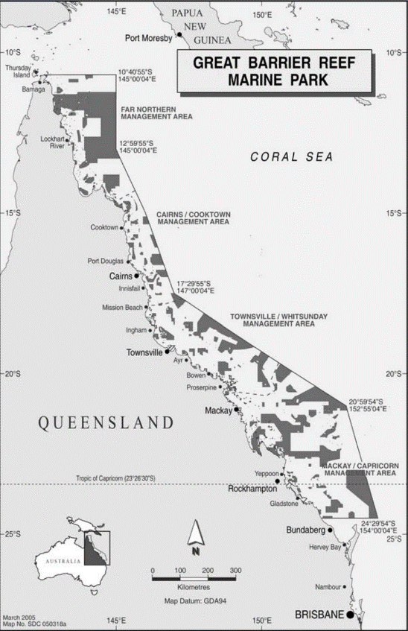
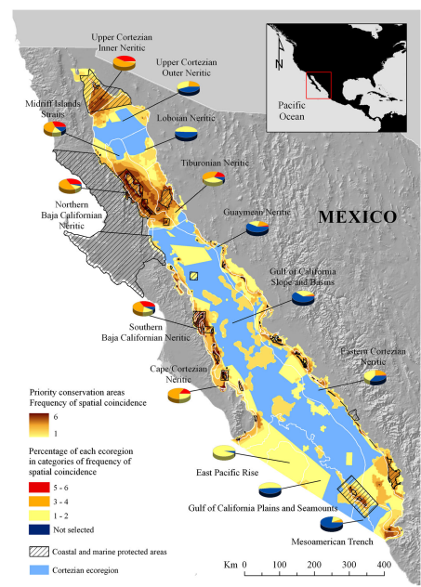
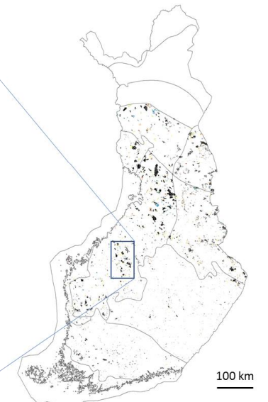
Systematic conservation planning
Great Barrier Reef, Australia
Gulf of California, Mexico
Finland
Fernandes et al. 2005
http://dx.doi.org/10.1111/j.1523-1739.2005.00302.x
Álvarez‐Romero et al. 2013
https://doi.org/10.1002/aqc.2334
Karaksela et al. 2020
https://doi.org/10.1016/j.biocon.2019.108324

Slide 8
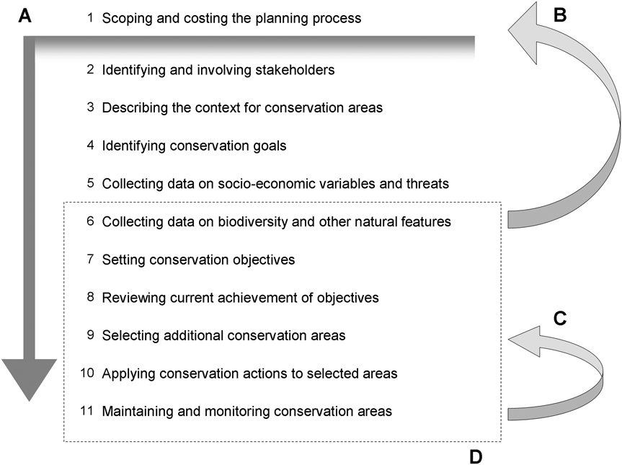
Systematic conservation planning (SCP)
Framework for evaluating ongoing management, prioritizing new actions, and monitoring their effectiveness
Objective driven
Stakeholder inclusive
Informed by data
Transparent + reproducible
Identifying fundamental objectives
Setting conservation targets
Selecting priority areas for conservation
Selecting priority areas for conservation
Pressey & Botrill 2009 https://doi.org/10.1017/S0030605309990500

Slide 9

Systematic conservation planning (SCP)
Framework for evaluating ongoing management, prioritizing new actions, and monitoring their effectiveness
Objective driven
Stakeholder inclusive
Informed by data
Transparent + reproducible
Identifying fundamental objectives
Setting conservation targets
Selecting priority areas for conservation
Pressey & Botrill 2009 https://doi.org/10.1017/S0030605309990500

Slide 10
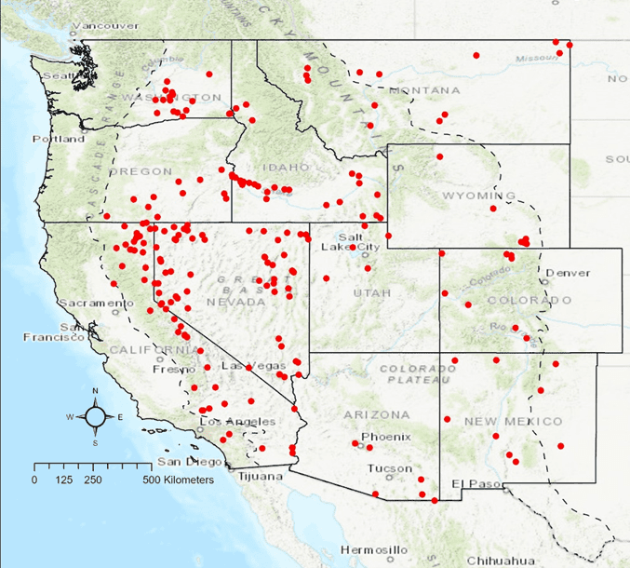
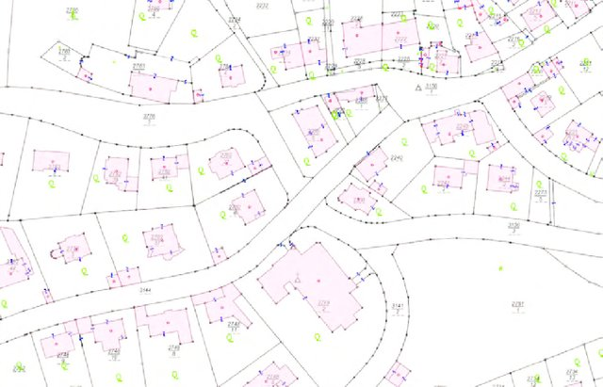
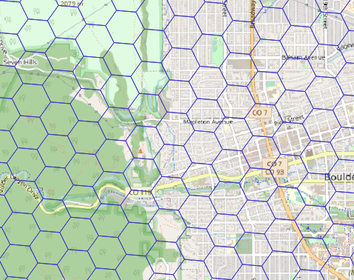
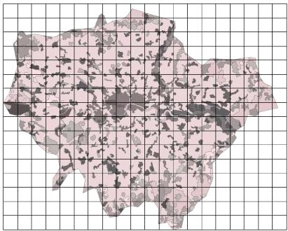
Terminology: “planning units”
Sites (point localities)
Discrete spatial areas
Managed independently
Scale appropriate for management and data uncertainty
Ideally include existing management areas
Potentially include places that not suitable for management
Property boundaries
Spatial grid (hexagonal)
Spatial grid (rectangular)
Giakoumi et al. 2025 https://doi.org/10.1016/j.tree.2024.12.002

Slide 11
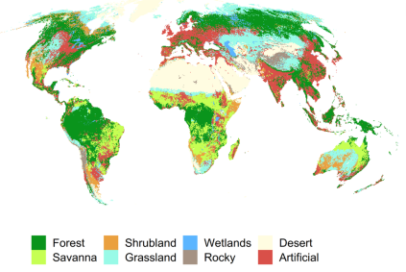
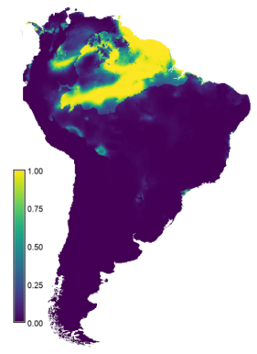
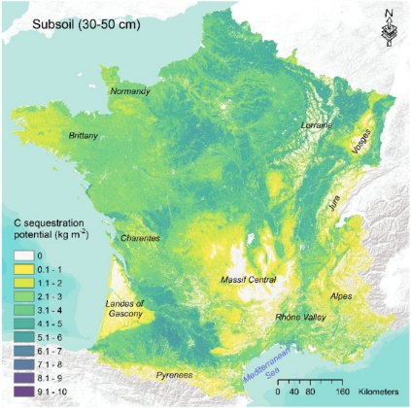
Terminology: “feature”
Habitat classification data
Typically a facet of biodiversity
Indicator variables used to represent fundamental objectives
Persistence is desirable
Need data for each planning unit (e.g., presence/absence, probability, amount, abundance)
E.g., species, habitat types, ecosystem services
Species distribution
model
Carbon sequestration potential
Giakoumi et al. 2025 https://doi.org/10.1016/j.tree.2024.12.002

Slide 12
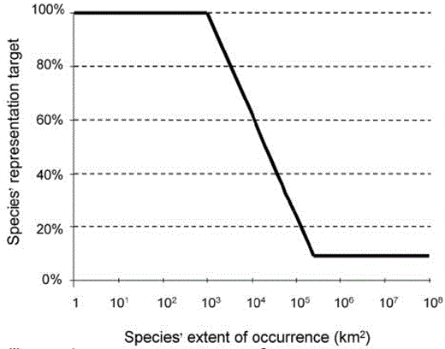
Terminology: “target”
Minimum threshold level of coverage (representation) required for a feature
Different features will often have different targets
Often set as a percentage
E.g., set based on policy, statistical models, expert elicitation, or published methods
Rodrigues et al. 2000 https://doi.org/10.1641/0006-3568(2004)054[1092:GGAPRF]2.0.CO;2

Slide 13
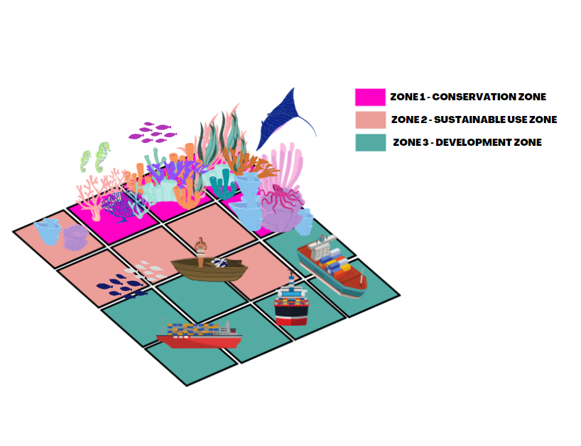
Terminology: “zone”
Each zone represents an alternative management option
E.g., conservation zone (no fishing/shipping permitted), sustainable zone (limited fishing permitted, no shipping permitted), development (no restrictions)
Most exercises consider only a single protected area zone
May require features that are not related to biodiversity (e.g., shipping lanes, crop production, forestry production)
Very data hungry
Neubert et al. (2025) https://doi.org/10.1016/j.tree.2025.09.007, https://marxansolutions.org

Slide 14
Principles for conservation planning
Important to ensure that conservation goals meet fundamental objectives and so that priority areas, in turn, receive focused, effective, and efficient conservation efforts.
Identifying fundamental objectives
Setting conservation goals/targets
Selecting priority areas for conservation
Pressey & Botrill 2009 https://doi.org/10.1017/S0030605309990500

Slide 15



Principle of connectivity
“improve population resilience to disturbance, increase metapopulation viability, promote genetic diversity and maintain energetic pathways among ecosystems”
Within-reserve connectivity
Daigle et al. 2020 https://doi.org/10.1111/2041-210X.13349

Slide 16
Principle of connectivity
“improve population resilience to disturbance, increase metapopulation viability, promote genetic diversity and maintain energetic pathways among ecosystems”
Between-reserve connectivity
Highway
Daigle et al. 2020 https://doi.org/10.1111/2041-210X.13349

Slide 17
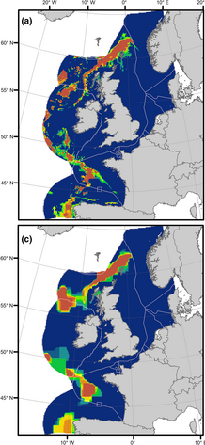
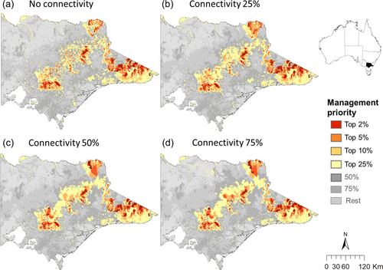
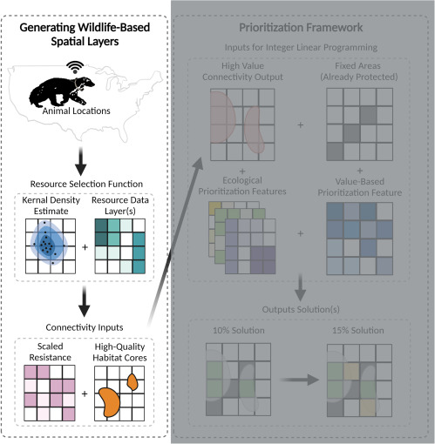
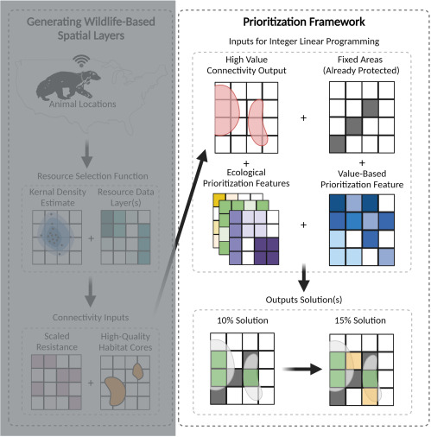
Accounting for connectivity
Baseline
Spatial
clustering
Carter et al. 2024 https://doi.org/10.1002/eap.2982
Carroll 2021
https://doi.org/10.1016/j.xpro.2021.100882
Giménez et al. 2023 https://doi.org/10.1002/aqc.4015

Slide 18


Principle of comprehensiveness
“A comprehensive reserve system […] contains examples of many biodiversity features, where biodiversity features might include species, habitats, or ecological processes.”
versus
Possingham, H. P., Wilson, K. A., Andelman, S. J. & Vynne, C. H. (2006). Protected areas: goals, limitations and design. In Principles of Conservation Biology (eds M. J. Groom, G. K. Meffe and C. R. Carroll), pp. 509–533. Sunderland, Sinauer Associates.

Slide 19
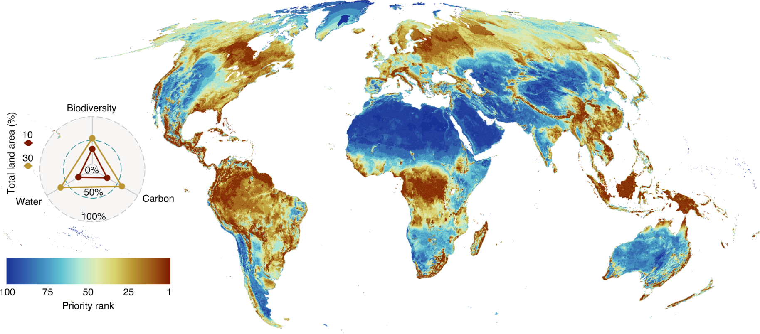
Accounting for comprehensiveness
Amphibians, mammals, birds, reptiles, plants, water provisioning, carbon sequestration
Jung et al. 2021 https://doi.org/10.1038/s41559-021-01528-7

Slide 20
Principle of adequacy
“One approach […] is to set conservation goals […] to ensure persistence of the feature”
versus
Conservation goal is ≥ 3 ×
Commonwealth of Australia (1992). National Forest Policy Statement: A New Focus for Australia's Forests. Advance Press, Perth.
Wilson, K. A., Cabeza, M. & Klein, C. J. (2009). Fundamental concepts of spatial conservation prioritization. In Spatial Conservation Prioritization (eds A. Moilanen, K. A. Wilson and H. P. Possingham), pp. 16–27. Oxford University Press, Oxford.

Slide 21

Accounting for adequacy – set good targets!
target = minimum coverage required for a feature (e.g., species)
Statistical models “[…] area required to achieve a less than 5% chance of the Leadbeater’s Possum population falling to (or below) 500 or fewer adult females in 40 generations ”
Friedrichs et al. 2018 https://doi.org/10.1371/journal.pone.0208264
Taylor et al. 2017 https://doi.org/ 10.1371/journal.pone.0169629
Jung et al. 2021 https://doi.org/10.1038/s41559-021-01528-7
Smith et al. 2022 https://doi.org/10.1111/csp2.578

Slide 22
Accounting for adequacy – set good targets!
target = minimum coverage required for a feature (e.g., species)
Statistical models “[…] area required to achieve a less than 5% chance of the Leadbeater’s Possum population falling to (or below) 500 or fewer adult females in 40 generations ”
Expert elicitation “Targets […] set by the expert group through an iterative process designed to ensure the nature recovery network met the broad objectives set out by BBOWT”
Friedrichs et al. 2018 https://doi.org/10.1371/journal.pone.0208264
Taylor et al. 2017 https://doi.org/ 10.1371/journal.pone.0169629
Jung et al. 2021 https://doi.org/10.1038/s41559-021-01528-7
Smith et al. 2022 https://doi.org/10.1111/csp2.578

Slide 23
Accounting for adequacy – set good targets!
target = minimum coverage required for a feature (e.g., species)
Statistical models “[…] area required to achieve a less than 5% chance of the Leadbeater’s Possum population falling to (or below) 500 or fewer adult females in 40 generations ”
Expert elicitation “Targets […] set by the expert group through an iterative process designed to ensure the nature recovery network met the broad objectives set out by BBOWT”
Published methods “We set species targets to conserving the minimum amount of species’ habitat necessary to qualify it for the conservation status ‘Least Concern’ following IUCN Red List criteria”
Friedrichs et al. 2018 https://doi.org/10.1371/journal.pone.0208264
Taylor et al. 2017 https://doi.org/ 10.1371/journal.pone.0169629
Jung et al. 2021 https://doi.org/10.1038/s41559-021-01528-7
Smith et al. 2022 https://doi.org/10.1111/csp2.578

Slide 24
Accounting for adequacy – set good targets!
target = minimum coverage required for a feature (e.g., species)
Statistical models “[…] area required to achieve a less than 5% chance of the Leadbeater’s Possum population falling to (or below) 500 or fewer adult females in 40 generations ”
Expert elicitation “Targets […] set by the expert group through an iterative process designed to ensure the nature recovery network met the broad objectives set out by BBOWT”
Published methods “We set species targets to conserving the minimum amount of species’ habitat necessary to qualify it for the conservation status ‘Least Concern’ following IUCN Red List criteria”
Policy “As a habitat-specific target, we used 17% of the total number of PUs where the respective habitat occurs, adopting Aichi target 11”
Friedrichs et al. 2018 https://doi.org/10.1371/journal.pone.0208264
Taylor et al. 2017 https://doi.org/ 10.1371/journal.pone.0169629
Jung et al. 2021 https://doi.org/10.1038/s41559-021-01528-7
Smith et al. 2022 https://doi.org/10.1111/csp2.578

Slide 25
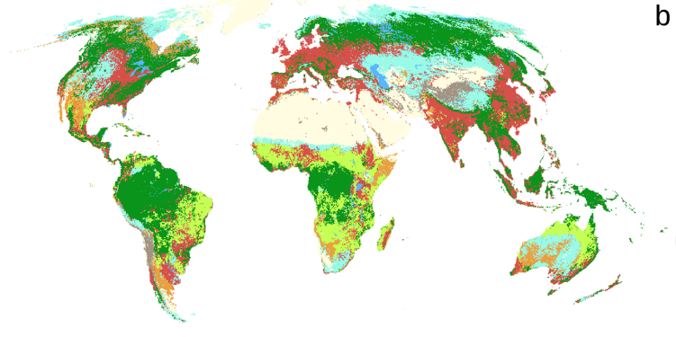
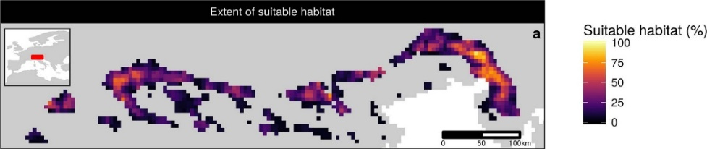
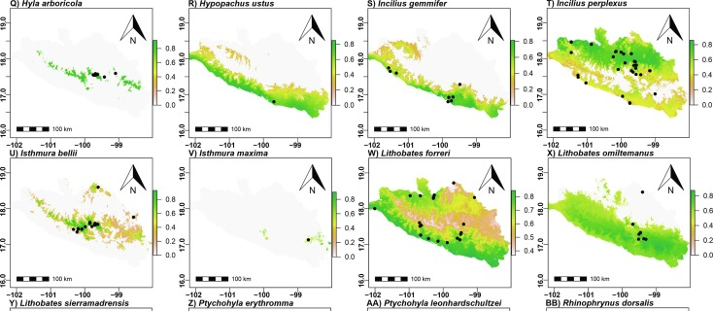
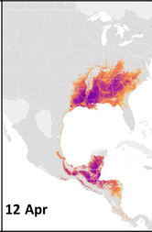
Accounting for adequacy – get good data!
Area of habitat data
Hanson et al. 2020 https://doi.org/s41586-020-2138-7
Habitat classification
Jung et al. 2020 https://doi.org/10.1038/s41597-020-00599-8
Modelled abundance
Fink et al. 2020 https://doi.org/10.1002/eap.2056
Species distribution models
González-Fernández et al. 2022 https://doi.org/10.1016/j.jnc.2022.126235

Slide 26


Principle of representativeness
“represent, or sample, the full variety of biodiversity, ideally at all levels of organization.”
versus
Margules & Pressey 2000 https://doi.org/10.1038/35012251

Slide 27
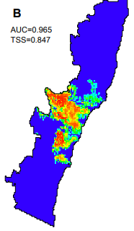
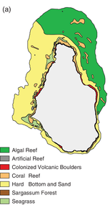
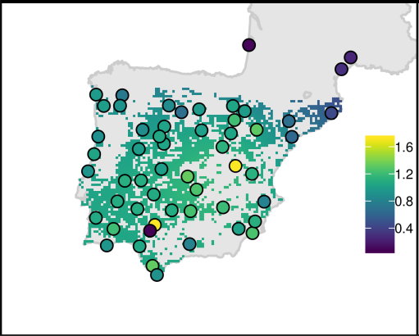
Accounting for representativeness
Species
Ecosystems
Genes
Hanson et al. 2022
https://doi.org/10.1111/1365-2664.13718
Domisch et al. 2019
https://doi.org/10.1111/ddi.12891
Flower et al. 2020
https://doi.org/10.1111/csp2.158

Slide 28

Principle of efficiency
“An efficient reserve system is more likely to succeed in the face of competing interests.”
versus
Possingham, H. P., Wilson, K. A., Andelman, S. J. & Vynne, C. H. (2006). Protected areas: goals, limitations and design. In Principles of Conservation Biology (eds M. J. Groom, G. K. Meffe and C. R. Carroll), pp. 509–533. Sunderland, Sinauer Associates.

Slide 29
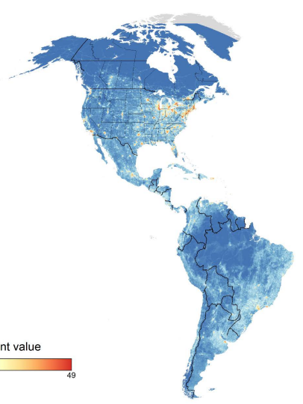
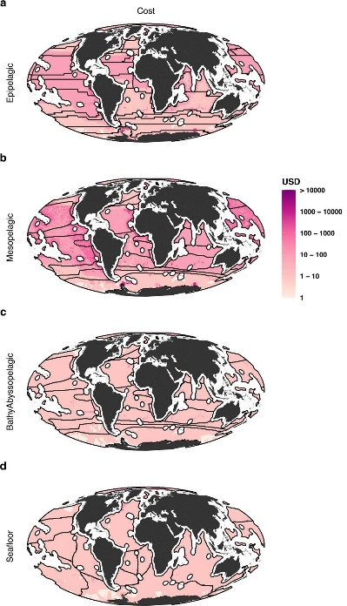
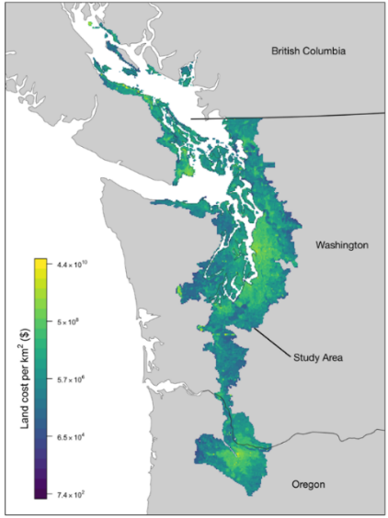
Accounting for efficiency – get good cost data
Land value assessments
Human pressure
Opportunity cost to commercial fisheries
Rodewald et al. 2019
https://doi.org/10.1038/s41598-019-52241-2
Schuster et al. 2019
https://doi.org/10.1038/s41467-019-09723-8
Brito-Morales et al. 2022
https://doi.org/10.1038/s41558-022-01323-7

Slide 30
Principle of complementarity
Existing protected areas and priority areas should “complement” each other to maximize the performance of the overall system
Do not simply prioritize the places that would be considered “best” in isolation!
Vane-Wright et al. 1991 https://doi.org/10.1016/0006-3207(91)90030-D

Slide 31
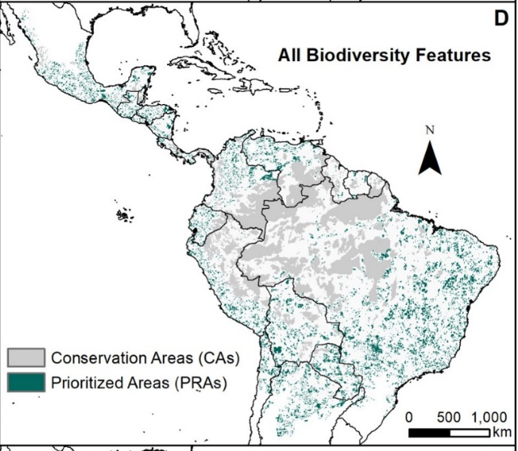
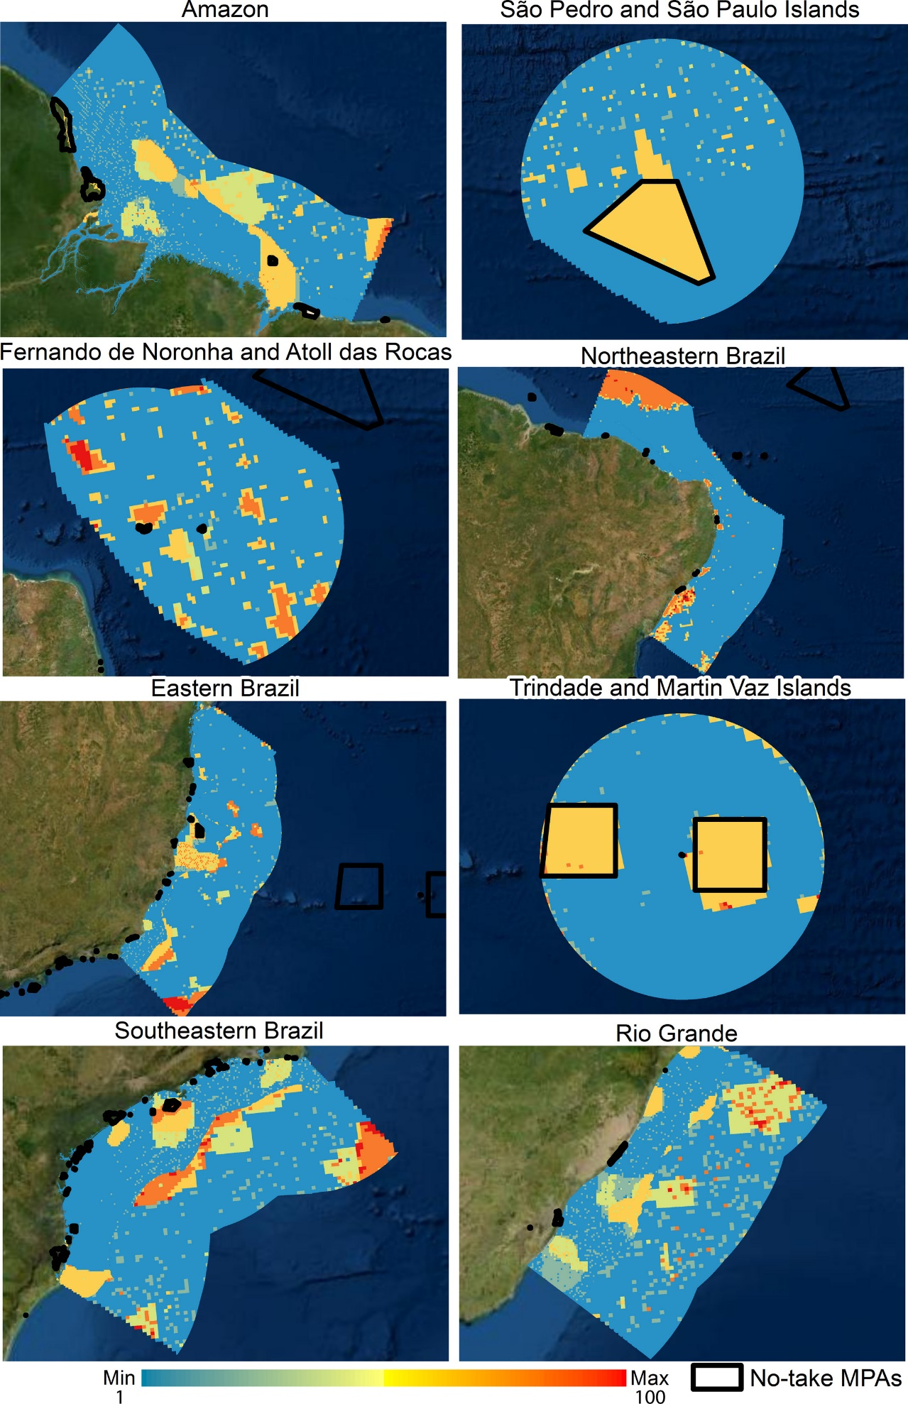
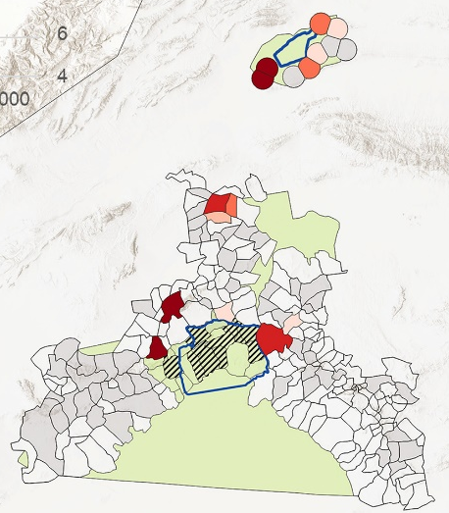

Accounting for complementarity – use existing conservation areas
Protected areas +
Indigenous Lands
No-take marine reserves
Areas with existing habitat + pastures where grazing rights have already been bought
Burbano-Girón et al. 2022
https://doi.org/10.1016/j.biocon.2021.109421
Magris et al. 2020
https://doi.org/10.1111/ddi.13183
Daberger et al. 2022
https://doi.org/ 10.1111/csp2.12832

Slide 32






Accounting for complementarity – use good algorithms
Heuristic
algorithms
Meta-heuristic
algorithms
Exact algorithms
Estimate of best solution
Quality
Different
solutions
Different
solutions
Different
solutions
Note version 5+ uses a different algorithm

Slide 33
Mixed integer linear problem
Min:
+7
+2
+5
+9
+1
+0
+1
+1
≥ 1
+1
+1
+0
+1
≥ 1
V. types
B
B
B
B
Upper bound
1
1
1
1
Lower bound
0
0
0
0
Solution
0
1
1
0

Slide 34
Model sense
Min:
+7
+2
+5
+9
+1
+0
+1
+1
≥ 1
+1
+1
+0
+1
≥ 1
V. types
B
B
B
B
Upper bound
1
1
1
1
Lower bound
0
0
0
0
Solution
0
1
1
0

Slide 35
Objective
Min:
+7
+2
+5
+9
+1
+0
+1
+1
≥ 1
+1
+1
+0
+1
≥ 1
V. types
B
B
B
B
Upper bound
1
1
1
1
Lower bound
0
0
0
0
Solution
0
1
1
0

Slide 36
Constraints
Min:
+7
+2
+5
+9
+1
+0
+1
+1
≥ 1
+1
+1
+0
+1
≥ 1
V. types
B
B
B
B
Upper bound
1
1
1
1
Lower bound
0
0
0
0
Solution
0
1
1
0

Slide 37
Constraints
Sense
Min:
+7
+2
+5
+9
+1
+0
+1
+1
≥ 1
Coefficients
RHS
+1
+1
+0
+1
≥ 1
V. types
B
B
B
B
Upper bound
1
1
1
1
Lower bound
0
0
0
0
Solution
0
1
1
0

Slide 38
Variables
Min:
+7
+2
+5
+9
+1
+0
+1
+1
≥ 1
+1
+1
+0
+1
≥ 1
V. types
B
B
B
B
Upper bound
1
1
1
1
Lower bound
0
0
0
0
Solution
0
1
1
0

Slide 39
Variables
Min:
+7
+2
+5
+9
+1
+0
+1
+1
≥ 1
+1
+1
+0
+1
≥ 1
V. types
B
B
B
B
Upper bound
1
1
1
1
Lower bound
0
0
0
0
Solution
0
1
1
0

Slide 40
Variables
Min:
+7
+2
+5
+9
+1
+0
+1
+1
≥ 1
+1
+1
+0
+1
≥ 1
V. types
C
B
B
I
Upper bound
Inf
1
1
5
Lower bound
-Inf
0
1
2
Solution
0
1
1
0

Slide 41
Solution
Min:
+7
+2
+5
+9
+1
+0
+1
+1
≥ 1
+1
+1
+0
+1
≥ 1
V. types
B
B
B
B
Upper bound
1
1
1
1
Lower bound
0
0
0
0
Solution
0
1
1
0

Slide 42





Conservation planning as optimization
Minimum set formulation
Objective: min. # of islands
Constraints: sufficient habitat for each species
Decisions: create a reserve on an island or not?

Slide 44
1
2
3
4
5
6
7
8
9

Slide 45
1
2
3
4
5
6
7
8
9
1
2
3
4
5
6
7
8
9

Slide 46
1
2
3
4
5
6
7
8
9

Slide 47
Upper
1
1
1
1
1
1
1
1
1
Lower
0
0
0
0
0
0
0
0
0
V. type
B
B
B
B
B
B
B
B
B
1
2
3
4
5
6
7
8
9

Slide 48
Min $:
+1
+1
+1
+1
+1
+1
+1
+1
+1
Upper
1
1
1
1
1
1
1
1
1
Lower
0
0
0
0
0
0
0
0
0
V. type
B
B
B
B
B
B
B
B
B
1
2
3
4
5
6
7
8
9

Slide 49
Min $:
+1
+1
+1
+1
+1
+1
+1
+1
+1
1
2
3
4
5
6
7
8
+1
9
+1
Upper
1
1
1
1
1
1
1
1
1
Lower
0
0
0
0
0
0
0
0
0
V. type
B
B
B
B
B
B
B
B
B
1
2
3
4
5
6
7
8
9

Slide 50
Min $:
+1
+1
+1
+1
+1
+1
+1
+1
+1
1
2
3
4
5
6
7
8
+1
9
+1
+1
Upper
1
1
1
1
1
1
1
1
1
Lower
0
0
0
0
0
0
0
0
0
V. type
B
B
B
B
B
B
B
B
B
1
2
3
4
5
6
7
8
9

Slide 51
Min $:
+1
+1
+1
+1
+1
+1
+1
+1
+1
+1
1
2
3
4
5
6
+1
7
8
+1
9
+1
+1
Upper
1
1
1
1
1
1
1
1
1
Lower
0
0
0
0
0
0
0
0
0
V. type
B
B
B
B
B
B
B
B
B
1
2
3
4
5
6
7
8
9

Slide 52
Min $:
+1
+1
+1
+1
+1
+1
+1
+1
+1
+1
+1
+1
+1
+1
+1
+1
+1
+1
+1
+1
+1
Upper
1
1
1
1
1
1
1
1
1
Lower
0
0
0
0
0
0
0
0
0
V. type
B
B
B
B
B
B
B
B
B
1
2
3
4
5
6
7
8
9

Slide 53
Min $:
+1
+1
+1
+1
+1
+1
+1
+1
+1
+1
≥ 1
+1
+1
≥ 1
+1
+1
≥ 1
+1
≥ 1
+1
+1
+1
+1
+1
+1
≥ 1
Upper
1
1
1
1
1
1
1
1
1
Lower
0
0
0
0
0
0
0
0
0
V. type
B
B
B
B
B
B
B
B
B
1
2
3
4
5
6
7
8
9

Slide 54



Min $:
+1
+1
+1
+1
+1
+1
+1
+1
+1
+1
≥ 1
+1
+1
≥ 1
+1
+1
≥ 1
+1
≥ 1
+1
+1
+1
+1
+1
+1
≥ 1
Upper
1
1
1
1
1
1
1
1
1
Lower
0
0
0
0
0
0
0
0
0
V. type
B
B
B
B
B
B
B
B
B
1
2
3
4
5
6
7
8
9

Slide 55
Min $:
+1
+1
+1
+1
+1
+1
+1
+1
+1
+1
≥ 1
+1
+1
≥ 1
+1
+1
≥ 1
+1
≥ 1
+1
+1
+1
+1
+1
+1
≥ 1
Upper
1
1
1
1
1
1
1
1
1
Lower
0
0
0
0
0
0
0
0
0
V. type
B
B
B
B
B
B
B
B
B
1
2
3
4
5
6
7
8
9

Slide 56
1
2
3
4
5
6
7
8
9
1
2
3
4
5
6
7
8
9

Slide 57
But reality is
more complex…

Slide 58
Accounting for existing conservation areas
Min $:
+1
+1
+1
+1
+1
+1
+1
+1
+1
+1
≥ 1
+1
+1
≥ 1
+1
+1
≥ 1
+1
≥ 1
+1
+1
+1
+1
+1
+1
≥ 1
Upper
1
1
1
1
1
1
1
1
1
Lower
0
1
0
0
0
0
1
0
0
V. type
B
B
B
B
B
B
B
B
B
1
2
3
4
5
6
7
8
9

Slide 59
Accounting for efficiency
Min $:
+9
+2
+5
+1
+5
+8
+3
+6
+8
+1
≥ 1
+1
+1
≥ 1
+1
+1
≥ 1
+1
≥ 1
+1
+1
+1
+1
+1
+1
≥ 1
Upper
1
1
1
1
1
1
1
1
1
Lower
0
1
0
0
0
0
1
0
0
V. type
B
B
B
B
B
B
B
B
B
1
2
3
4
5
6
7
8
9

Slide 60
Accounting for adequacy, comprehensiveness, and representativeness
Min $:
+9
+2
+5
+1
+5
+8
+3
+6
+8
+10
≥ 10
+2
+5
≥ 7
+3
+7
≥ 3
+1
≥ 1
+9
+8
+9
+8
+4
+3
≥ 12
Upper
1
1
1
1
1
1
1
1
1
Lower
0
1
0
0
0
0
1
0
0
V. type
B
B
B
B
B
B
B
B
B
1
2
3
4
5
6
7
8
9

Slide 61
Accounting for connectivity
Min $:
+9
+2
+5
+1
+5
+8
+3
+6
+8
+10
≥ 10
+2
+5
≥ 7
+3
+7
≥ 3
+1
≥ 1
+9
+8
+9
+8
+4
+3
≥ 12
Upper
1
1
1
1
1
1
1
1
1
Lower
0
1
0
0
0
0
1
0
0
V. type
B
B
B
B
B
B
B
B
B
1
2
3
4
5
6
7
8
9

Slide 62
What if connectivity = 1/distance?
Min $:
+9
+2
-3*1/5
Let’s just consider islands 1 and 2
-1
+1
≤ 0
+1
-1
1
2
≤ 0
-1
-1
+1
≥ -1
5 km
Upper
1
1
1
Lower
0
1
0
V. type
B
B
B
1
2
1&2
Scaling factor: 3 connectivity units = 1 cost unit
Beyer et al. 2016
https://doi.org/10.1016/j.ecolmodel.2016.02.005

Slide 63
What if connectivity = 1/distance?
Min $:
+9
+2
-3*1/5
Let’s just consider islands 1 and 2
(1)
-1
+1
≤ 0
1
(2)
+1
-1
≤ 0
1
2
-1
-1
+1
≥ -1
5 km
Upper
1
1
1
Lower
0
1
0
V. type
B
B
B
1
2
1&2
So, +1 variable and +2 constraints per pair of planning units.. increases problem size a lot!
E.g., 1k planning =
~500k extra constraints

Slide 64

prioritizr
Human readable code
Design your problem
Solve it fast!
Hanson et al. 2025 https://doi.org/10.1111/cobi.14376

Slide 65
Package workflow
Data
Input to solver
Formulation
Solver settings
Solve problem
Maps
Statistics

Slide 66
Package workflow
Data
Input to solver
Formulation
Solver settings
Solve problem
Maps
Statistics

Slide 67
Package workflow
Data
Input to solver
Formulation
Solver settings
Solve problem
Maps
Statistics

Slide 68
Human-readable code
Code
Mental model
p <-
problem(areas, feats) %>%
add_min_set_objective() %>%
add_boundary_penalties(5) %>%
add_relative_targets(0.1) %>%
add_neighbor_constraints(2) %>%
add_locked_in_constraints(“in”) %>%
add_binary_decisions() %>%
add_rsymphony_solver()
solution <- solve(p)
problem <-
data +
objective +
penalties +
constraints +
constraints +
constraints +
decision type +
solver settings
solution <- solve(problem)

Slide 69
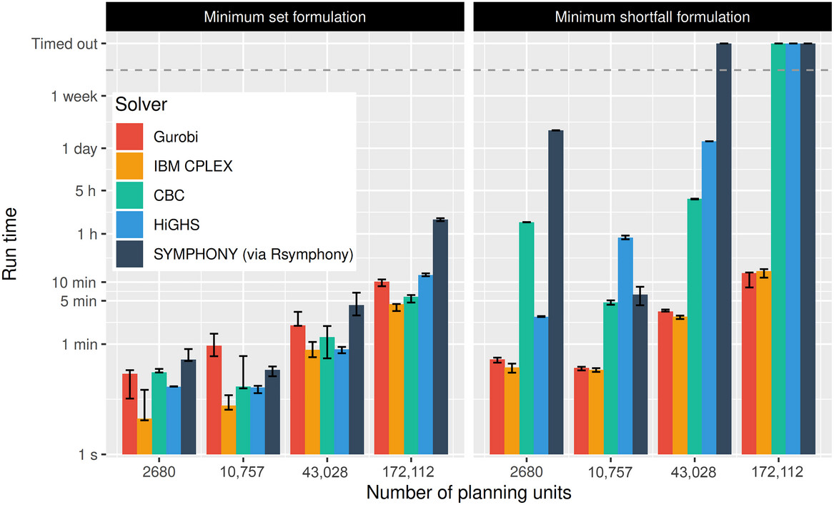
Solve it fast!
Hanson et al. 2025 https://doi.org/10.1111/cobi.14376, Schuster et al. 2020 https://doi.org/10.7717/peerj.9258

Slide 70
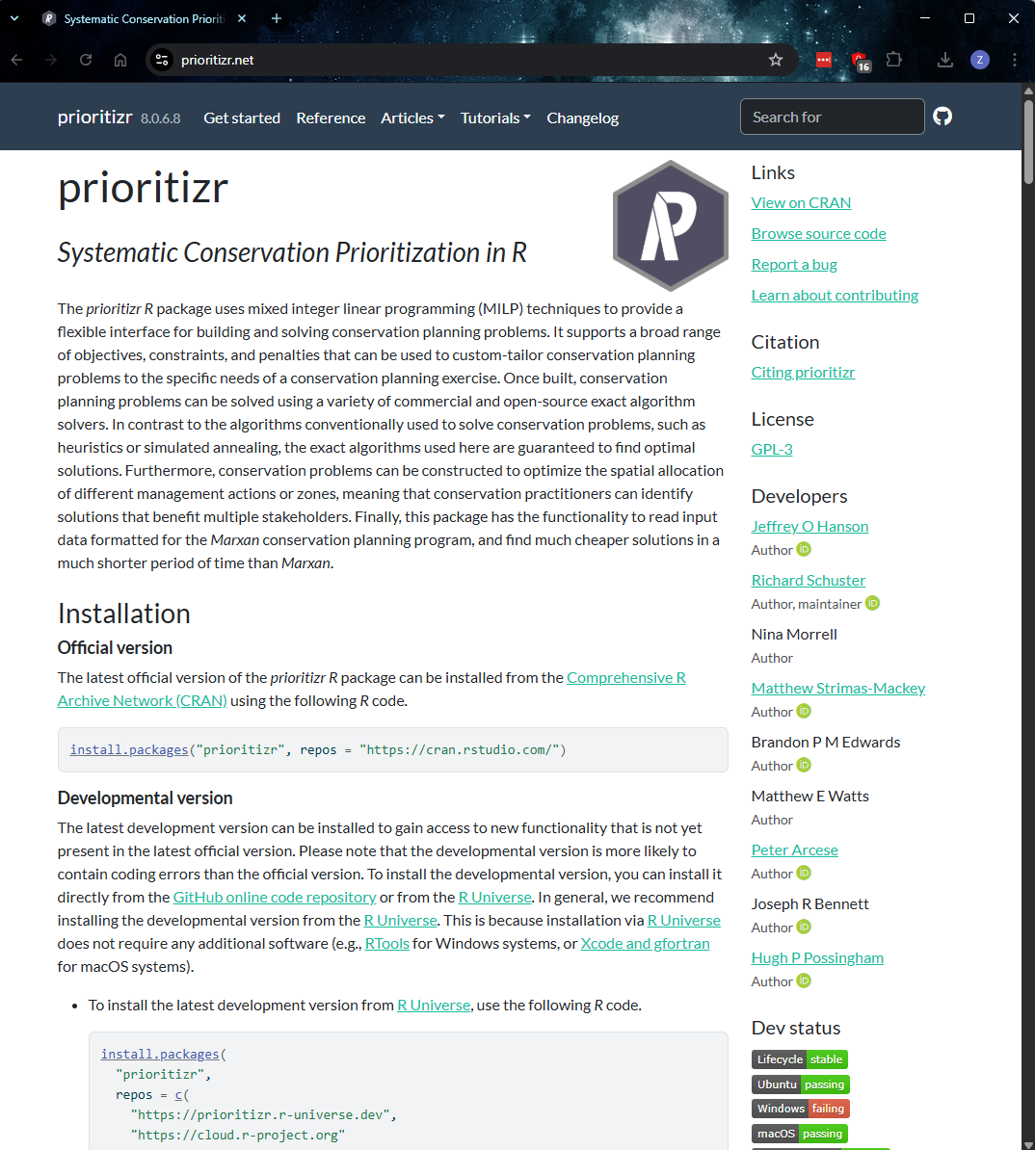


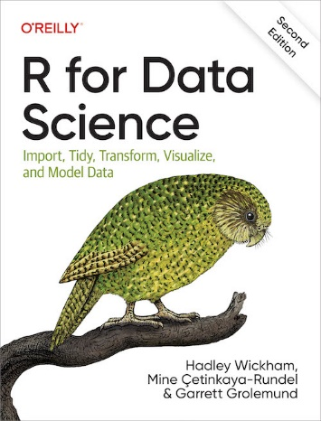
Getting help
Prioritizr website (https://prioritizr.net/) has documentation, examples, tutorials, vignettes, workshop materials
Ask questions or report issues: https://github.com/prioritizr/prioritizr/ issues
See citations in this slideshow

Slide 71
Demo

Slide 72



richard.schuster@natureconservancy.ca
github.com/prioritizr/prioritizr
prioritizr.net

Slide 73
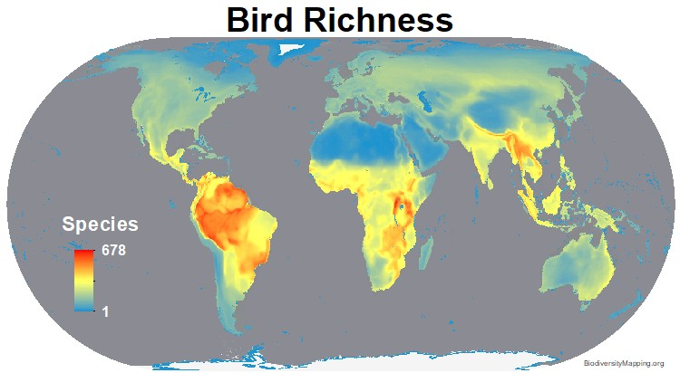
Can’t we just protect places with the greatest species richness/diversity?
Doesn’t account for:
Costs
Species’ requirements
Connectivity
Complementarity
Stakeholder preferences
Previous conservation efforts
https://biodiversitymapping.org
Brown et al. (2015) PNAS, DOI:10.1073/pnas.1509189112

Slide 74
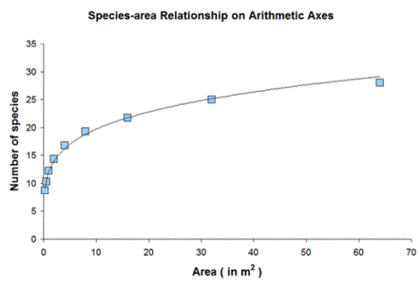
Biogeography says you get more species with larger area, so why not just maximize total amount of land inside protected areas?

Slide 75
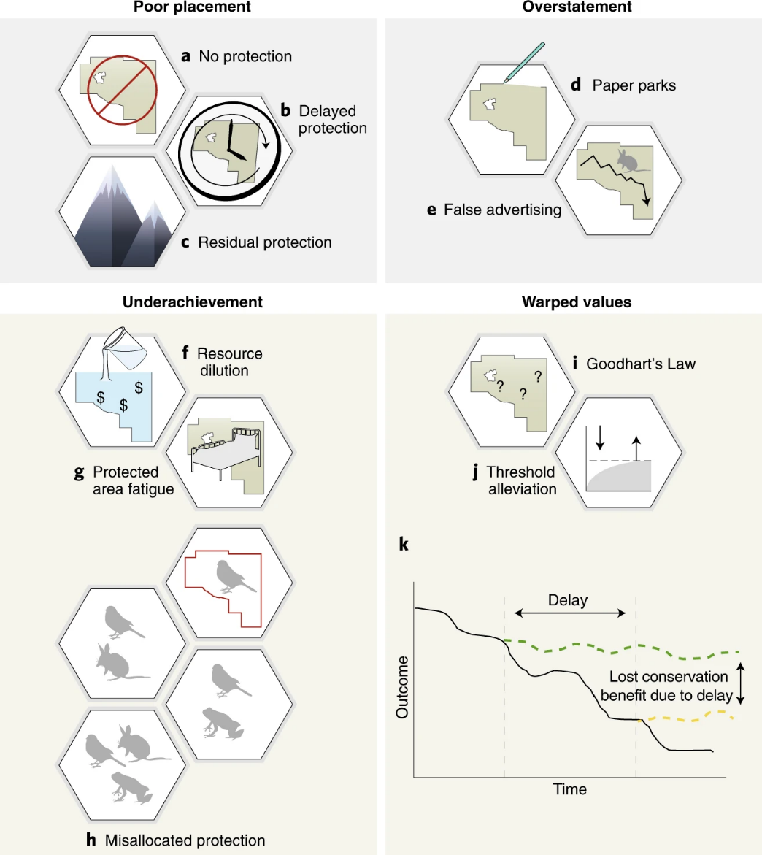
Focussing on protected area size creates perverse incentives
Failure to protect highly threatened, diverse, connected but small areas
Expansion results in delayed protection in areas where protected area (PA) establishment could have had much higher biodiversity benefits
Protection of low-threat, unrepresentative areas, generating limited protective effect
Fails to account for resources allocated to PA management; rewards lack of staff and equipment
Biodiversity losses in a PA remain undetected, but the area is celebrated as ‘protected’
Barnes et al. (2018) Nat Eco Evol, DOI:10.1038/s41559-018-0501-y

Slide 76

Focussing on protected area size creates perverse incentives
Protected area (PA) expansion without associated increases in budget or staff capacity reduces management capacity in situ and across the entire PA network.
PA expansion may induce apathy or resistance to establishing new PAs.
Poorly targeted expansions result […] in actions where biodiversity does not benefit, and limits opportunities for conservation.
Barnes et al. (2018) Nat Eco Evol, DOI:10.1038/s41559-018-0501-y

Slide 77

Focussing on protected area size creates perverse incentives
The real underlying values and objectives of halting biodiversity decline are subsumed by the metric of just protecting more land
As existing protected area coverage targets are thresholds, perceptions of success are binary, failing to account for continual improvements
Any delay or misallocation of limited resources causes long-term harm that may not be reversible at human timescales.
Barnes et al. (2018) Nat Eco Evol, DOI:10.1038/s41559-018-0501-y

Slide 78
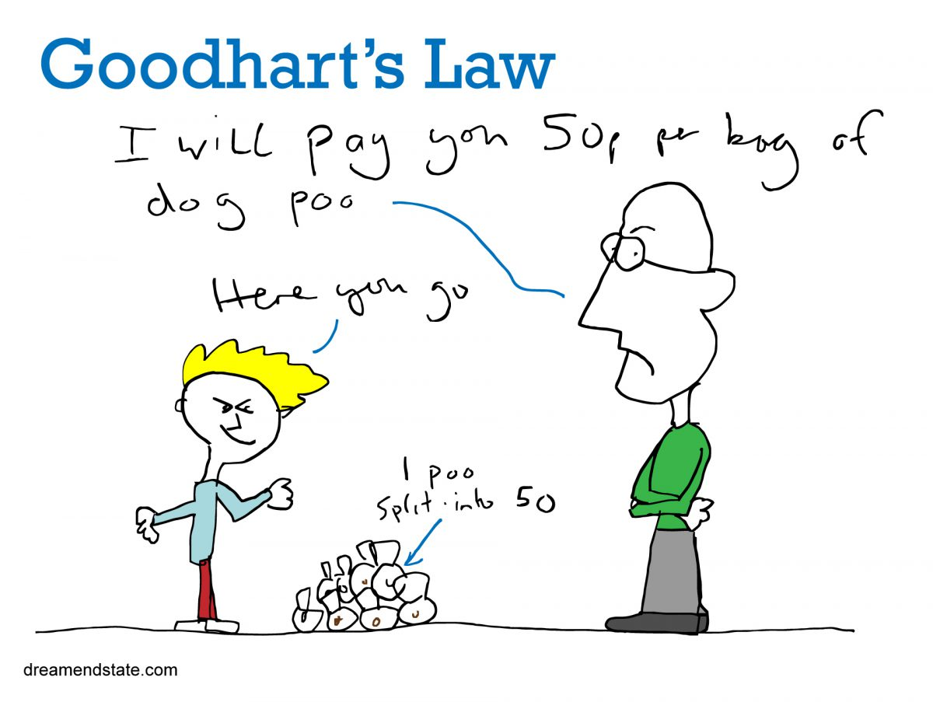
Focussing on protected area size creates perverse incentives

Slide 79
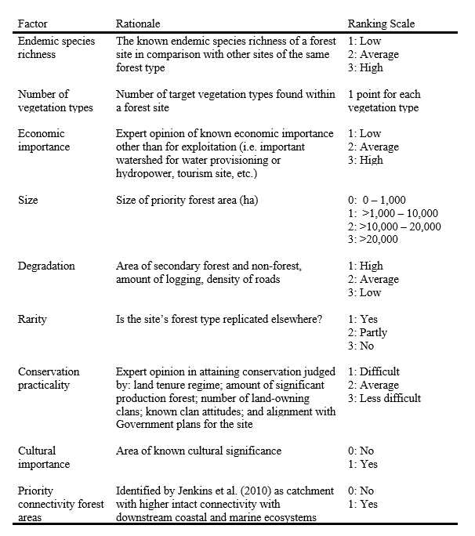
Can’t we just use a scoring system (formula) to rank candidate protected areas?
Game et al. (2013) Cons Biol,
DOI:10.1111/cobi.12051
Klein et al. (2014) Marine Policy,
DOI:10.1016/j.marpol.2013.10.001
Klein et al. (2014) Marine Policy,
DOI:10.1016/j.marpol.2014.03.008

Slide 80
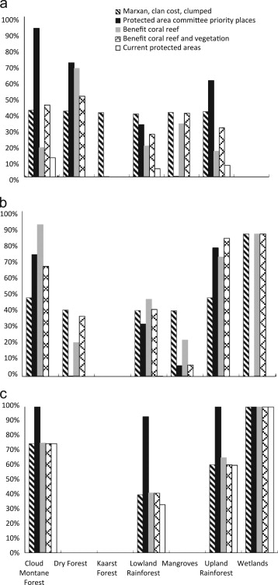
Can’t we just use a scoring system (formula) to rank candidate protected areas?
Plan for protected area network based on systematic conservation planning tool
Proportion of remaining vegetation represented in candidate protected area networks
Plan for protected area network based on scoring system
Representation target
Klein et al. (2014) Marine Policy,
DOI:10.1016/j.marpol.2013.10.001

Slide 81
Can’t we just use a scoring system (formula) to rank candidate protected areas?
Plan for protected area network based on systematic conservation planning tool
Proportion of remaining vegetation represented in candidate protected area networks
Plan for protected area network based on scoring system
Representation target
Klein et al. (2014) Marine Policy,
DOI:10.1016/j.marpol.2013.10.001

Slide 82
Look, I’m sure I could come up with a better formula?
“A major drawback of a listing of priority areas on the basis of a single application of a formula is that there is no guarantee that the priority area second or third on the list might not duplicate the species, communities or habitats that could successfully be preserved in the first priority area.”
Kirkpatrick (1983) Biol Cons, DOI: 10.1016/0006-3207(83)90056-3

Slide 83
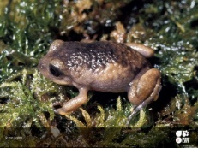
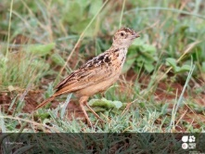

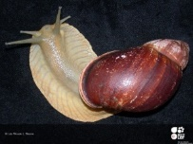
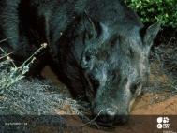
Representation targets don’t seem scientific, can’t the algorithm optimize this for me?
Carwardine et al. (2009), Cons Lett, DOI:10.1111/j.1755-263X.2008.00042.x

Slide 84
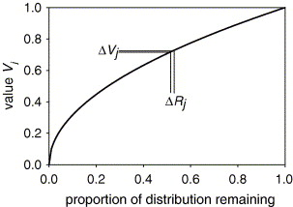
Zonation doesn’t use targets, doesn’t that make it more robust?
Zonation doesn’t use targets, but needs you to specify trade-off curves instead
These specify (1) how much worse covering X% of a species’ range is than Y%, and (2) how much worse loosing coverage of one species is compared to another
Here now
How bad is removing a certain planning unit?
Moilanen (2007) Biol Cons, DOI:10.1016/j.biocon.2006.09.008

Slide 85
Zonation doesn’t use targets, doesn’t that make it more robust?
1
Examples of different trade-off curves:
Rare species
Generalist species
Culturally important species
Only going below 5% coverage causes
steep drop
Fairly steady decrease in performance with reduction in coverage
Value
Going below ~90% coverage causes steep drop in performance
0
0%
50%
100%
Proportion of distribution remaining

Slide 86
You really think people will listen to a computer?
Systemic conservation planning helps:
support decision making – it doesn’t make decisions or dictate them
identify priority areas (just because the algorithm doesn’t say a place is a priority doesn’t necessarily mean it’s not important!)
facilitate discussions between stakeholders by navigating trade-offs
land-use and sea-scape planning by considering multiple zones (e.g. prioritizing places for recreational fishing and conservation)
real-world decision making, such as Great Barrier Reef (Australia), Gulf of California (Mexico), Cape Floristic Region, (South Africa), and marine planning (Montserrat)
Cowling et al. (2003) Biol Cons, DOI:10.1016/S0006-3207(02)00425-1
Álvarez-Romero et al. (2013) Aquatic Conserv, DOI:10.1002/aqc.2334
Fernandes et al. (2005) Conserv Biol, DOI:10.1111/j.1523-1739.2005.00302.x
Flower et al. (2020) Conserv Sci Prac, DOI:10.1111/csp2.158

Slide 87
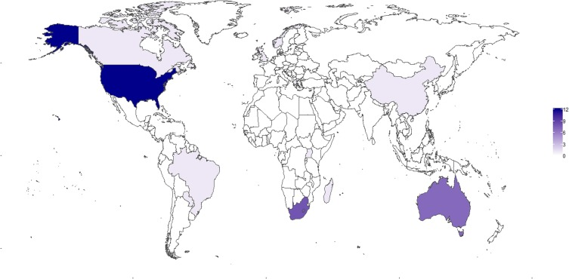
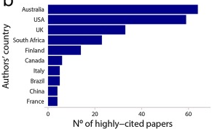
Isn’t conservation planning just something Australian’s do?
N° of highly-cited papers, based on study area
Ribeiro & Atadeu (2019) J. Nat. Conserv., DOI:10.1016/j.jnc.2019.125714

